Slide 1
Introduction
Name:-
Ahmad Usman
Master Name:-
Mr. Chen Kanging

Slide 2
DC Measuring Equipments
直流测量设备

Slide 3
Overview(概观 )
DC measuring equipment are very important part of HVDC system. We need to measure the DC electrical quantities like DC voltage and DC current for monitoring and protection purposes which are done by these equipments.
DC Electronic CT ( Optical CT)
Used for measuring DC current.
DC Electronic VT
Used for measuring DC Voltage.

Slide 4
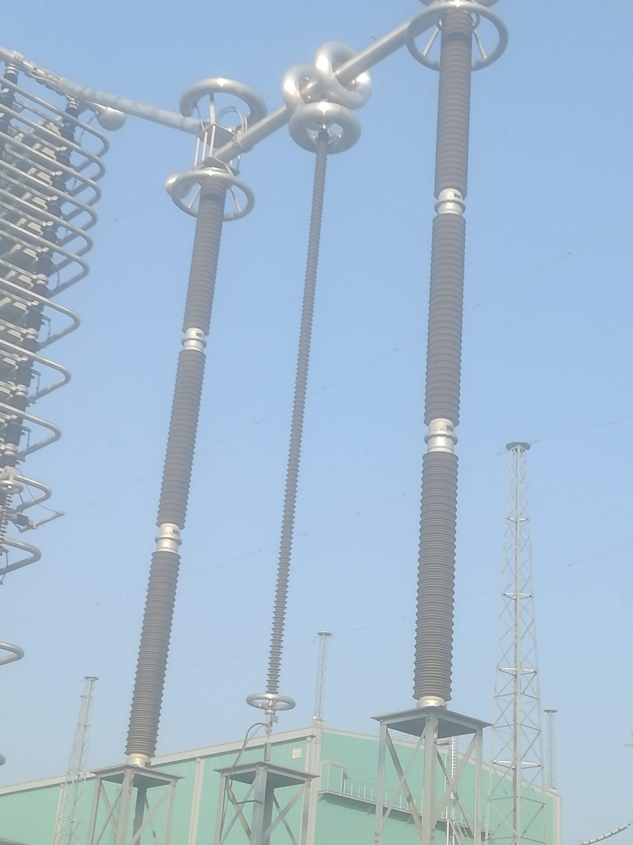
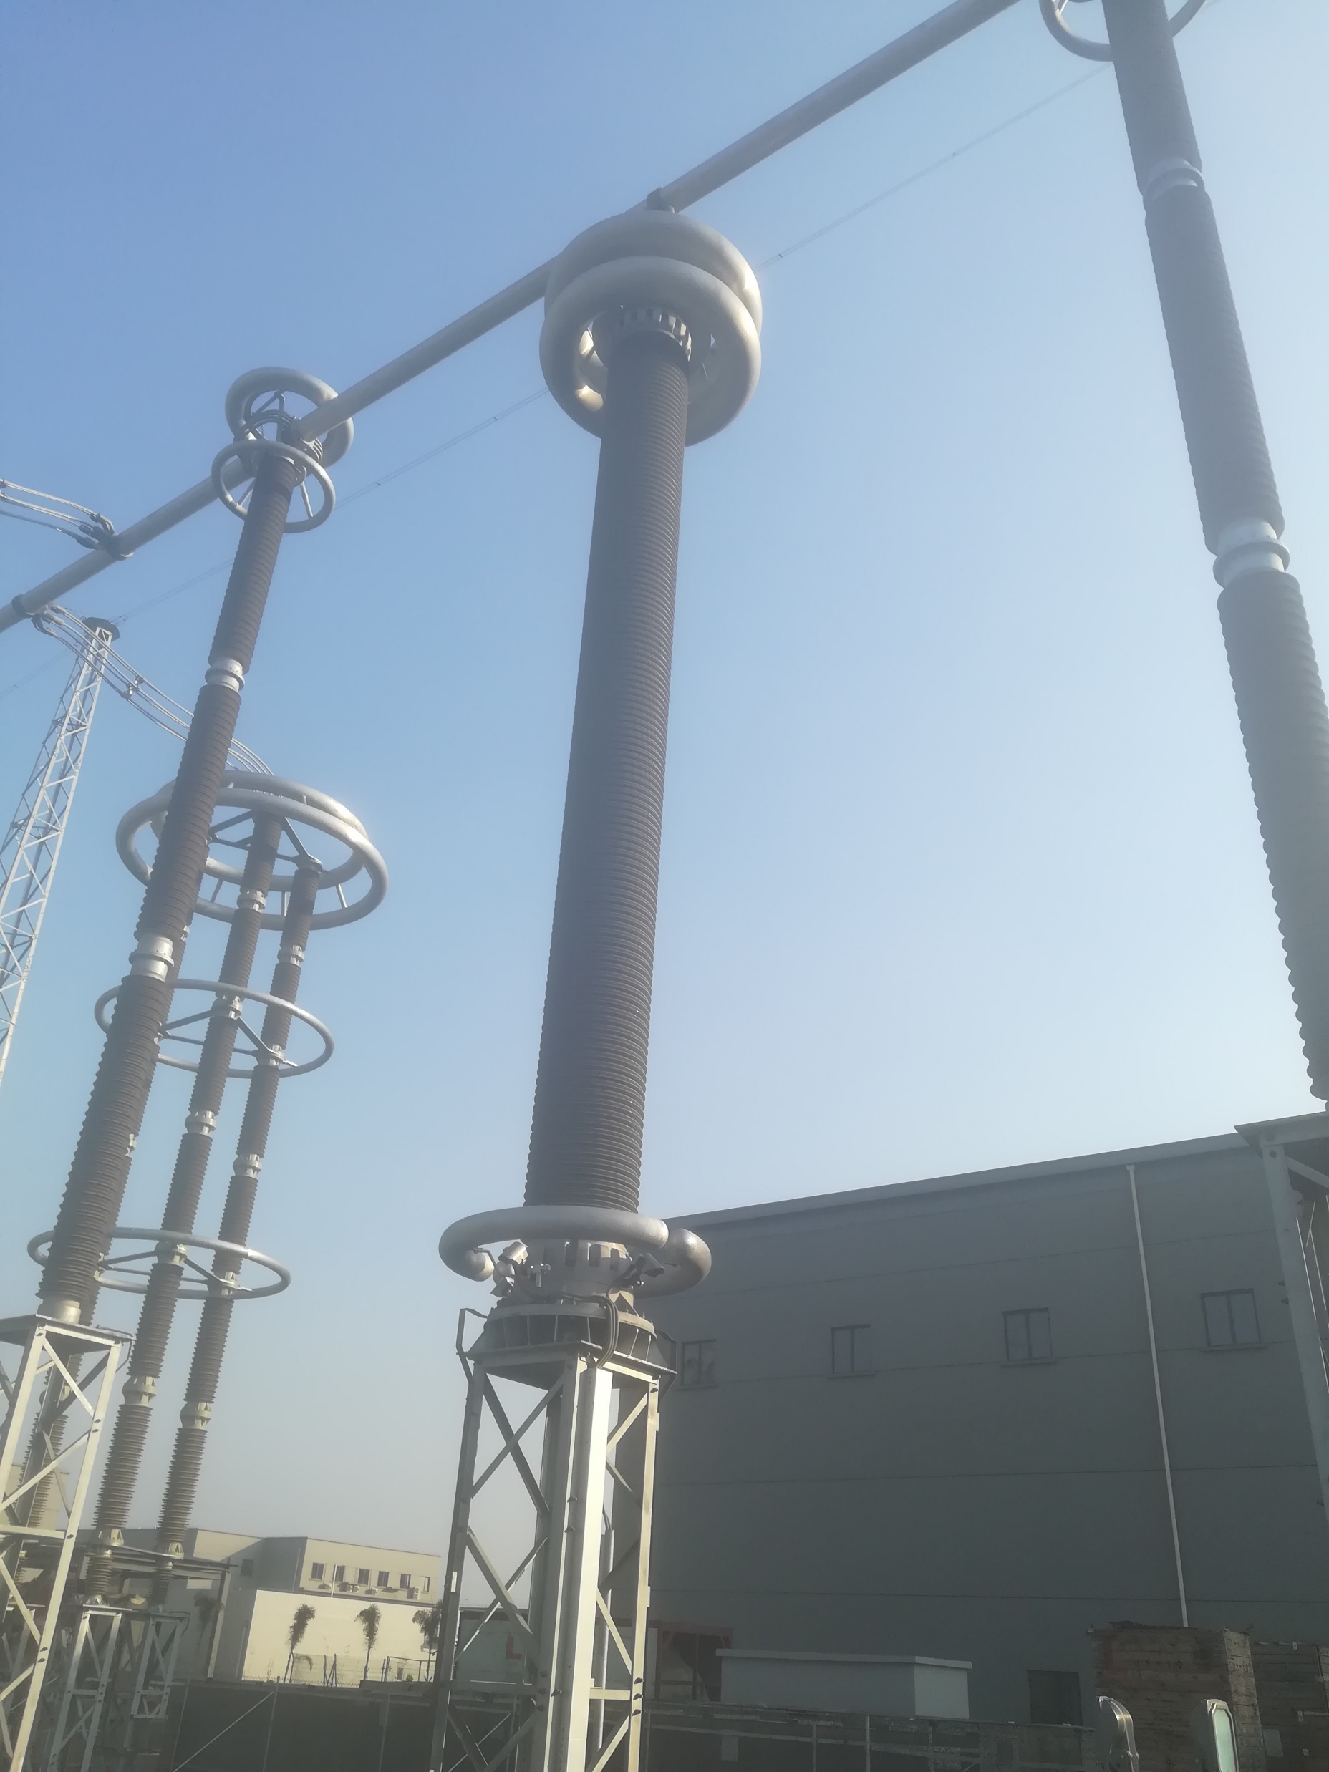
Function of DC Measuring Equipments
(直流测量设备的功能)
High Voltage Isolation.
Provides the isolation between high voltage side and low voltage circuit.
Proportional Transformation:
Transfer the primary high voltage and current to DC control and protection system in proportion.

Slide 5
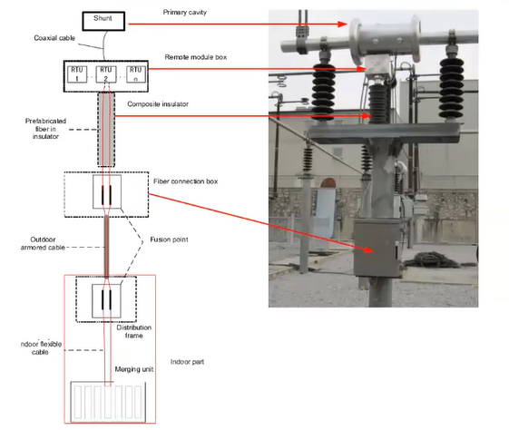
DC Electronic CT (Optical CT)
Optical CTs are intended for applications in HVDC converter stations. They measure DC current, harmonic current, and output digital signals for the protection and control devices in the converter station.
Working Principle:-
.

Slide 6
Structure of Optical CT
The DC electronic CTs are composed of the following parts:
• Primary Sensor: -
The primary sensor includes one current divider and one air core coil. The current divider is used to measure DC current and the air core coil is used to measure harmonic current. •
Resistor Board:-
It functions as signal distribution, converts one analogue signal to multiple signal outputs physically.
Remote Terminal Unit (RTU) :-
DC electronic CTs have multiple identical remote end modules, which can backup each other to guarantee high reliability. The remote module receives and processes the output signals from the current divider and the air core coil. It outputs serial digital optical signals. •

Slide 7
Structure of Optical CT
Composite Insulator:-
It is Embedded Optical Fiber This insulator adopts the composite material, while several multimode optical fibers are embedded inside as signal transmission media. •
Merging Unit:-
The merging unit is placed in control room. In one hand, it works as power supply for remote module by laser sending, in the other hand, it receives data from remote module. The output of merging units is sent to the protection and control according to protocol IEC 60044-8.

Slide 8
CT in Converter Station
Electronic CT
Electromagnetic CT
(Used in resistance and inductance branch of DC filter)
OPTICAL CT
Air Core
(Only used for harmonic current only)
Shunt
(Used for measuring DC Current)
LPCT
(Used for measuring unbalance current)

Slide 9
Place of Installation on Lahore Converter Station
Sr# | Rating | Installation point | Qty
1 | ±660KV, 3030.3A | For the DC current measurement of 660KV pole line current at outdoor valve top. | 02
2 | ±660KV, 3030.3A | For the DC current measurement of 660KV pole line current at outdoor DC field. | 02
3 | ±660KV, 3030.3A | For the DC current measurement of outdoor DC filter high voltage circuit current. | 04
4 | ±150KV, 3030.3A | For the DC current measurement of outdoor DC filter low voltage circuit current. | 04

Slide 10
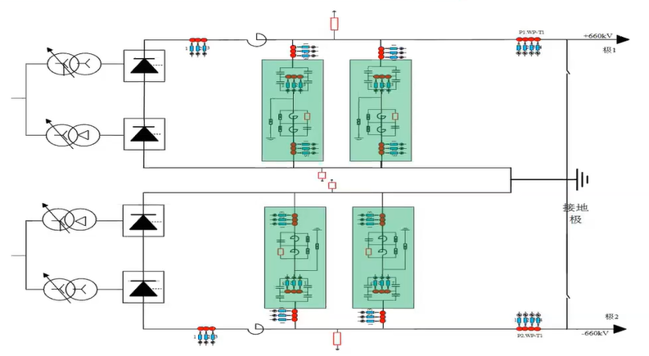
Place of Installation on Lahore Converter Station

Slide 11
Technical Parameters of Optical CT
Voltage level | 660KV & 150KV
DC withstand voltage | 1020KV & 225KV, 60 min
Lightening Impulse withstand voltage | 1800KV& 600KV
Operation Impulse withstand voltage | 1600KV&550KV
Rated Primary current | 3030.3A
Current Measurement Accuracy | 0.5
Rated secondary output | 1388H
Working Environment temperature | -40 to +70 degree centigrade
Rated short time thermocurrent | 24KA/ 3s
Rated Dynamic current | 60KA
Weight | 650Kg & 350Kg

Slide 12
Maintenance Instruction:
Sr# | Name | Period | Requirement
1 | Infrared Temperature Measurement | 1 Month | There shall be no obvious temperature difference between similar equipment’s
2 | Ultraviolet patrol | 1 year | Ultraviolet control equipment and conductor connection, no obvious discharge point
3 | Metal Component Inspection | 1 Month | All the metal components are not rusted, no heat discoloration
4 | Earthing flat iron | 1 Month | The earthing metal is well earthed, no corrosion.
5 | Insulator Inspection | 1 Month | No obvious dirt, no trace of discharging flashover
6 | Operation sound Inspection | 1 Month | There is no discharging sound or other sound inside, no abnormal smell.
7 | 4-Core double shielded armored cable earthing inspection. | 1 Month | Check if the grounding Cable is not loose and not rusted

Slide 13
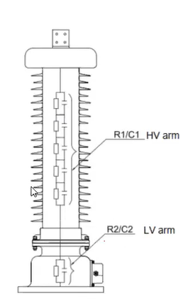
DC Electronic VT (PCS-9250 EAVD)
PCS-9250-EAVD DC Electronic VT is mainly applied the DC voltage measurement in HVDC Converter Station and outputs signal for the protection and control equipment. This project uses ±660KV, ±100KV Products.
Working Principle:-
It senses the DC voltage with precision resistor voltage divider, make sure frequency feature with shunt capacitor voltage divider, make sure insulation with optical composite insulator. This product has features like simple and reliable insulation design.

Slide 14
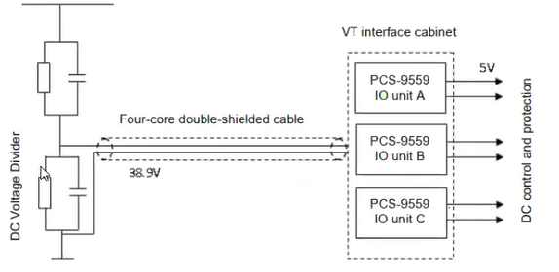
Structure of DCVT
The DC electronic VTs are composed of the following parts:
DC Voltage Divider:
It adopts resistor voltage divider with capacitor compensation, the resistor and capacitors are located in a silicon rubber composite-insulation cylinder, and the inside is filled with SF6 Gas.
PCS-9559 IO unit:
It is used for analogue quantity isolation, installed in the cabinet at the control room. The device is connected with DC voltage divider through four-core double-layer shielded cable. Each DC voltage divider is equipped with three sets of PCS-9559-IO unit. The rated output signal of PCS-9559 is 5V

Slide 15
Place of Installation on Lahore Converter Station
Sr# | Rating | Point of Installation | Qty
1 | ±660KV | For the measurement of Pole line voltage at outdoor DC field | 02
2 | ±100KV | For the measurement of neutral bus bar voltage at outdoor DC field | 02

Slide 16
Technical Parameters of DCVT
Voltage level | 660KV & 100KV
DC withstand voltage | 1020KV & 225KV, 60 min
Lightening Impulse withstand voltage | 1800KV& 600KV
Operation Impulse withstand voltage | 1600KV&550KV
Rated Secondary output | 5V
Voltage Measurement Accuracy | 0.2
Rated Gas Pressure | 0.35 Mpa
Working Environment temperature | -40 to +70 degree centigrade
Alarm gas pressure | 0.30/ 0.27 Mpa
Lock Air pressure | 0.22 Mpa
Working Environment temperature | -40 to +70 degree centigrade
Weight | 4000Kg & 330Kg

Slide 17
Maintenance Instruction:
Sr# | Name | Period | Requirement
1 | Infrared Temperature Measurement | 1 Month | There shall be no obvious temperature difference between similar equipment’s
2 | Ultraviolet patrol | 1 year | Ultraviolet control equipment and conductor connection, no obvious discharge point
3 | Metal Component Inspection | 1 Month | All the metal components are not rusted, no heat discoloration
4 | Earthing flat iron | 1 Month | The earthing metal is well earthed, no corrosion.
5 | Insulator Inspection | 1 Month | No obvious dirt, no trace of discharging flashover
6 | Operation sound Insoection | 1 Month | There is no discharging sound or other sound inside, no abnormal smell at site
7 | SF6 gas leakage inspection | 1 Month | Check the Gas pressure meter of DC voltage divider, the indication is in normal range

Slide 18
THANK YOU…!
谢谢

